Slide 1
GovHack 2023
The Smart Recycler
Generative AI Based Fully Automated Recyclable Waste Prediction and Management System
Solution by Gryffindor

Slide 2

AI based future recyclable waste prediction and management system (Victoria)
Challenge
Conduct analysis to understand and identify trends in recycling practices over the past 20 years. The objective of the challenge is to gain insights from recycling rates, material compositions, geographic variations and other factors influencing recycling behaviour.
Our aim is to create a more sustainable environment and ensure to efficiently utilize historical data to analyze trends and patterns in designing strategies for the future.
The main challenge is gathering the vast amount of historical data and using it to draw conclusions. To determine recycling trends and behaviors, we must analyze the large amounts of datasets collected from different business sectors( Residential, commercial and Industrial). The other difficulty is determining the impact of geographic variations on recycling behaviors by comparing the data from various regions.
Eligibility: Use at least 1 dataset from Data.Vic list.
Entry: Challenge entry is available to all teams in Australia.
Our Solution elements
Waste Datasets Collection, Classification and Preparation
Waste Composition Analysis
Environmental Impact Assessment based on time and region as well as waste type
Material Recovery Analysis
Behavioral Patterns, Recycling Rates and Trends
Enable smart waste collection bins for residentials and industries
Build Generative AI based fully automated robots to process and recycle the wastes.
Data Sets Used
National Waste Database
Victorian local government waste data
Victoria's waste projection model

Slide 3

Importance of waste recycling
Resource Conservation – conservation of natural resources, cut down on the need to extract and process resources that are energy-intensive
Landfill waste reduction - Minimize risks to the environment and human health because of improper waste disposal.
Reduced pollution - Recycling lessens the pollution that comes from waste disposal, manufacturing, and mining which can lead to habitat destruction and water pollution.
Energy Savings – Reduced energy consumption which contributes to reduced greenhouse gas emissions and mitigates climate change.
Preservation of Eco system – Lessens the need for land conversion, deforestation, and mining, thereby protecting ecosystems.

Slide 4
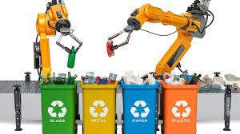
Actions and how we want to achieve
Data Collection and preparation – Collect pertinent historical data which includes waste composition, recycling rates, waste generation trends and recycling technologies from a variety of state-wide data sources and organize to satisfy the analytics requirements.
Waste Composition Analysis – Classify the waste stream's composition using the collected data, and identify recyclable materials, potential contamination problems, and waste reduction opportunities.
Environmental Impact Assessment - Analyze the collected data for various regions and compare the recycling rates, waste composition, recycling methods and technologies employed and environmental benefits of recycling practices in each region.
Material Recovery Analysis - Analyze the data to track the flow of materials that are gathered, sorted, processed, and ultimately recycled. Segregate waste based on AI and ML as well as image processing.
Recycling Rates and Trends – Identify the patterns in the data to generate the recycling rates which may vary based on the waste composition, waste management guidelines, public awareness campaigns, technological developments, and monetary conditions.
Technological Advances - Design algorithms to analyze data from waste streams, enabling more accurate waste characterization, sorting, and process optimization which helps in developing the strategy that can contribute to resource conservation, reduced landfilling, lower greenhouse gas emissions, and a more sustainable approach to waste management.

Slide 5
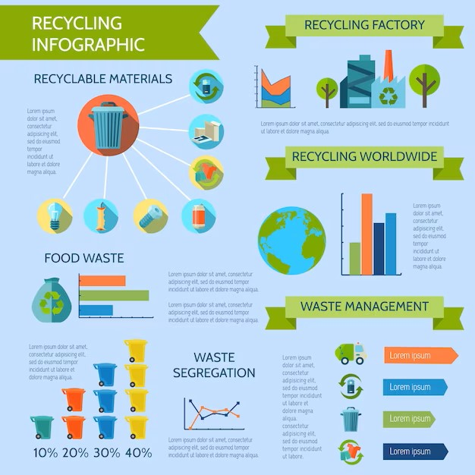
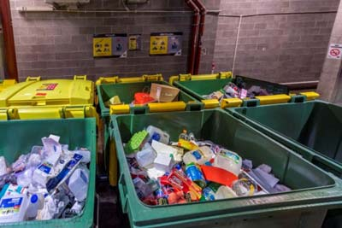
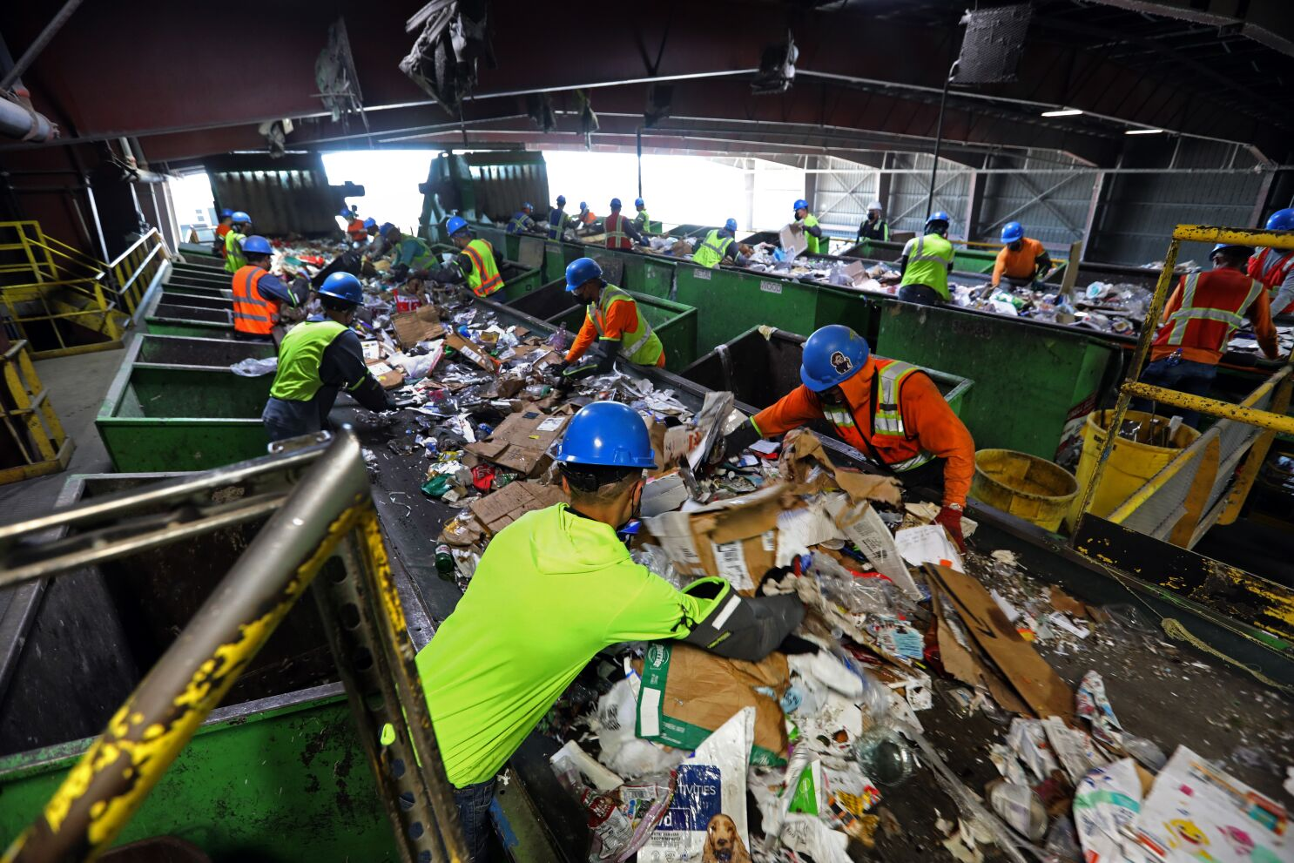
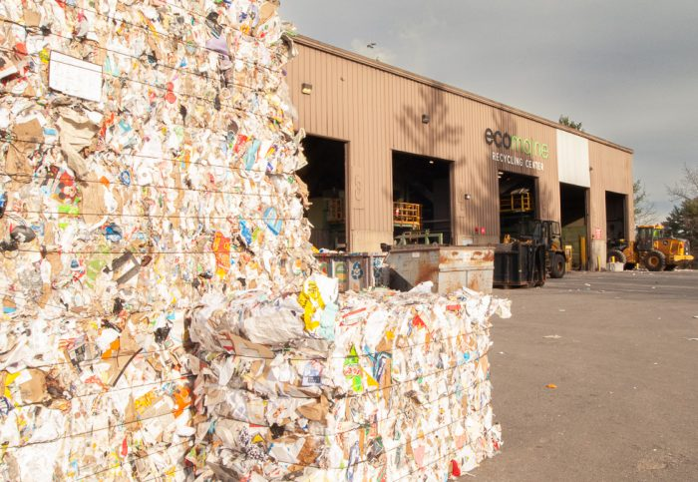

Current Waste Recycling Process
Key Process of Current waste collection and recycle (Traditional):
Collect the various waste related data across the state. This includes waste materials composition, economic variables and recycling rates.
Segregate the data based on various waste streams.
Utilize the data to determine the city's recycling rates and recyclable materials.
Currently there are lot of manual efforts required throughout the waste recycling process right from waste collection, segregation and waste recycling which may cause potential harm to the individuals involved due to the exposure of hazardous waste and handling dangerous hard materials.
In the future we are putting forth a solution based on fully automated robotic AI-based system that gives information on waste streams and
effective recycling technologies to AI robots that carry out the necessary waste recycling.
Waste Collection
Waste Segregation
Waste Recycling
Database
Recycled waste graphs & insights

Slide 6
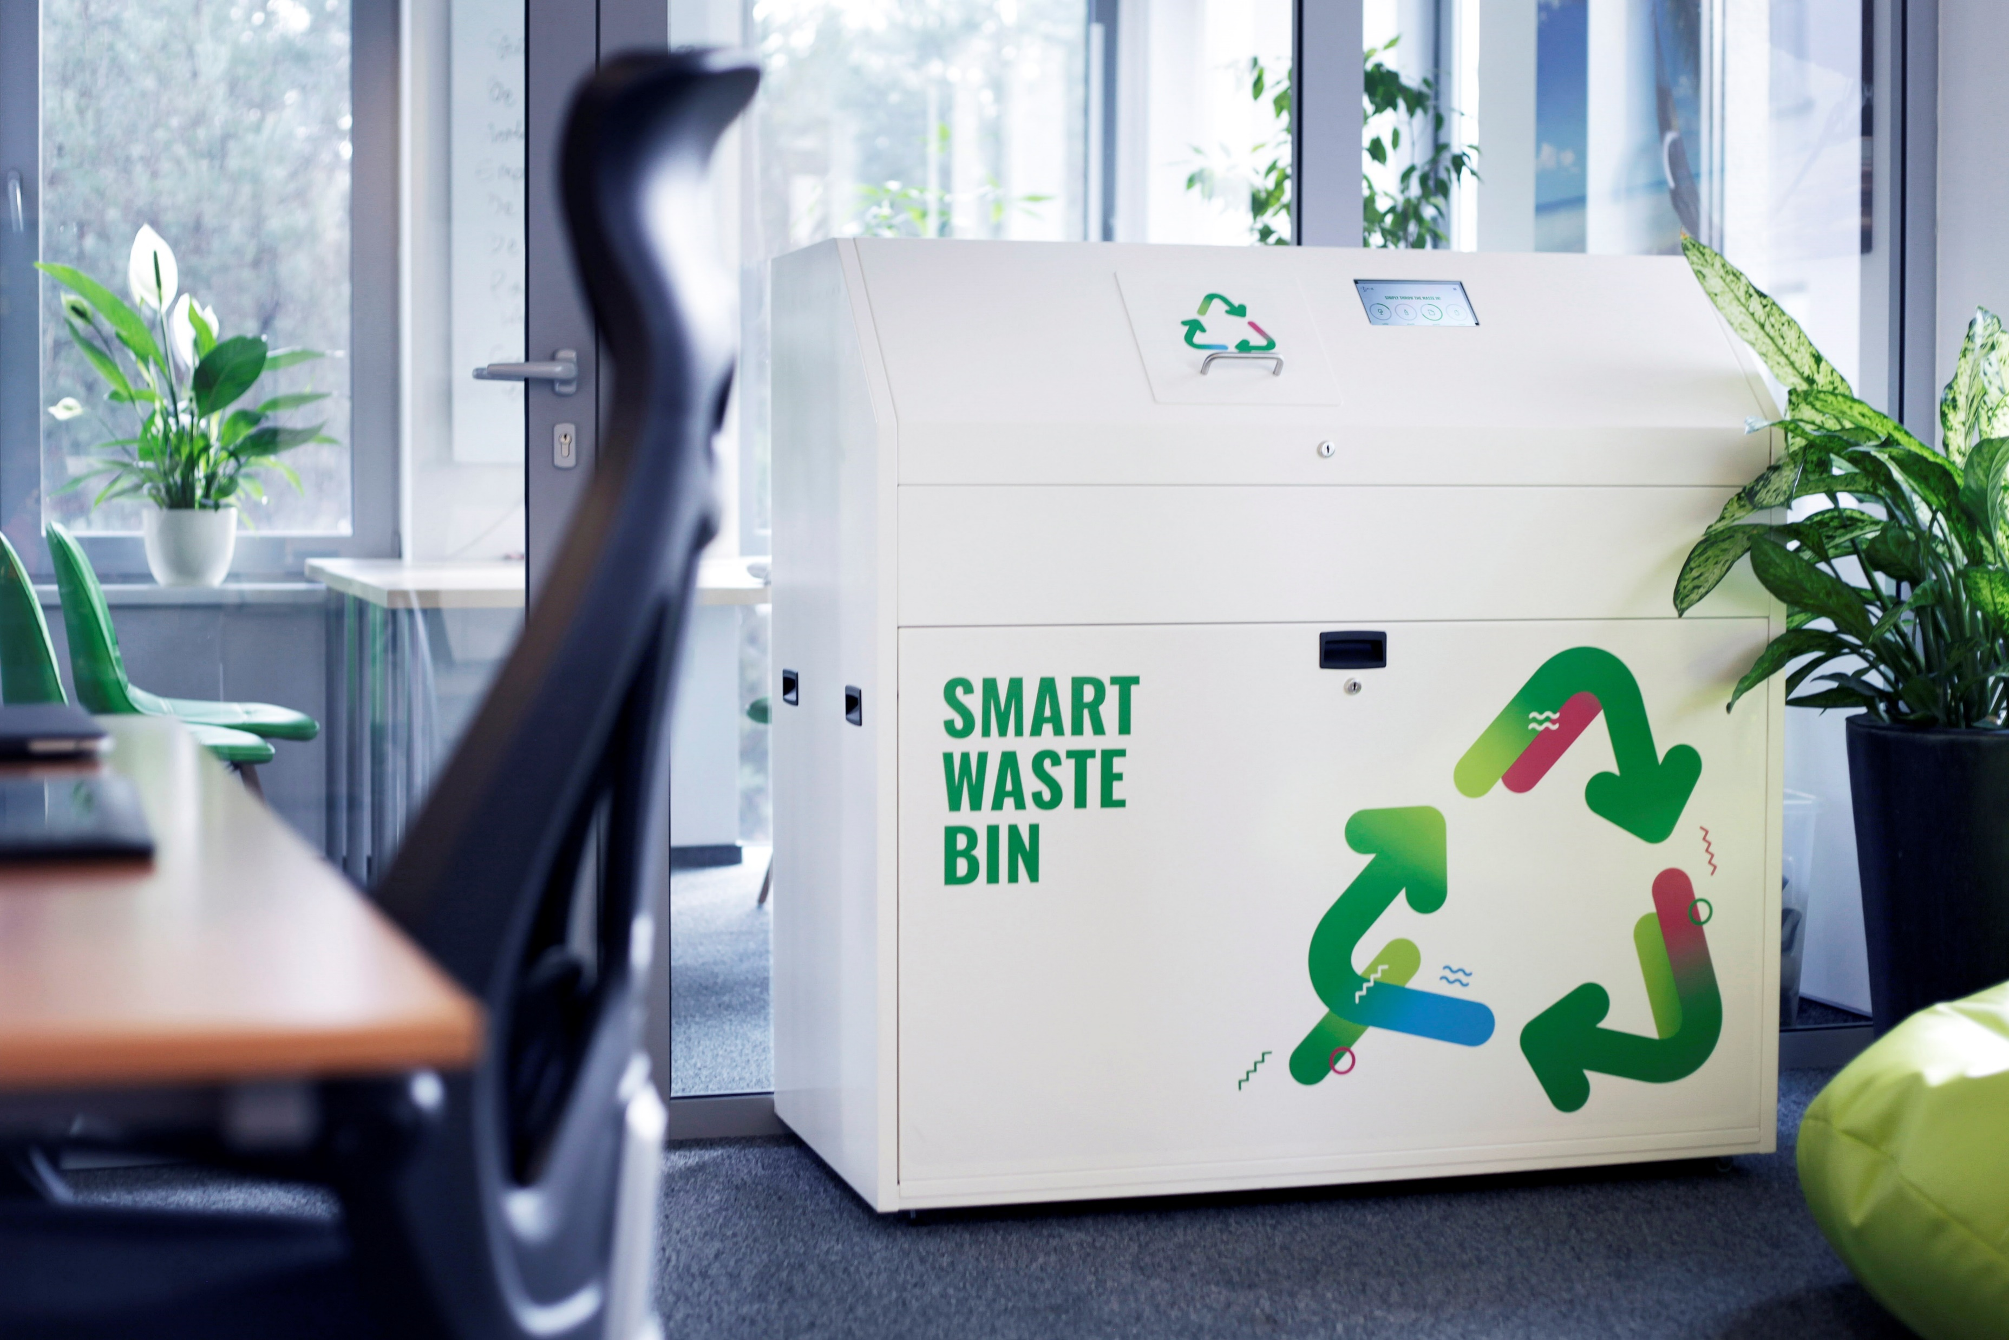

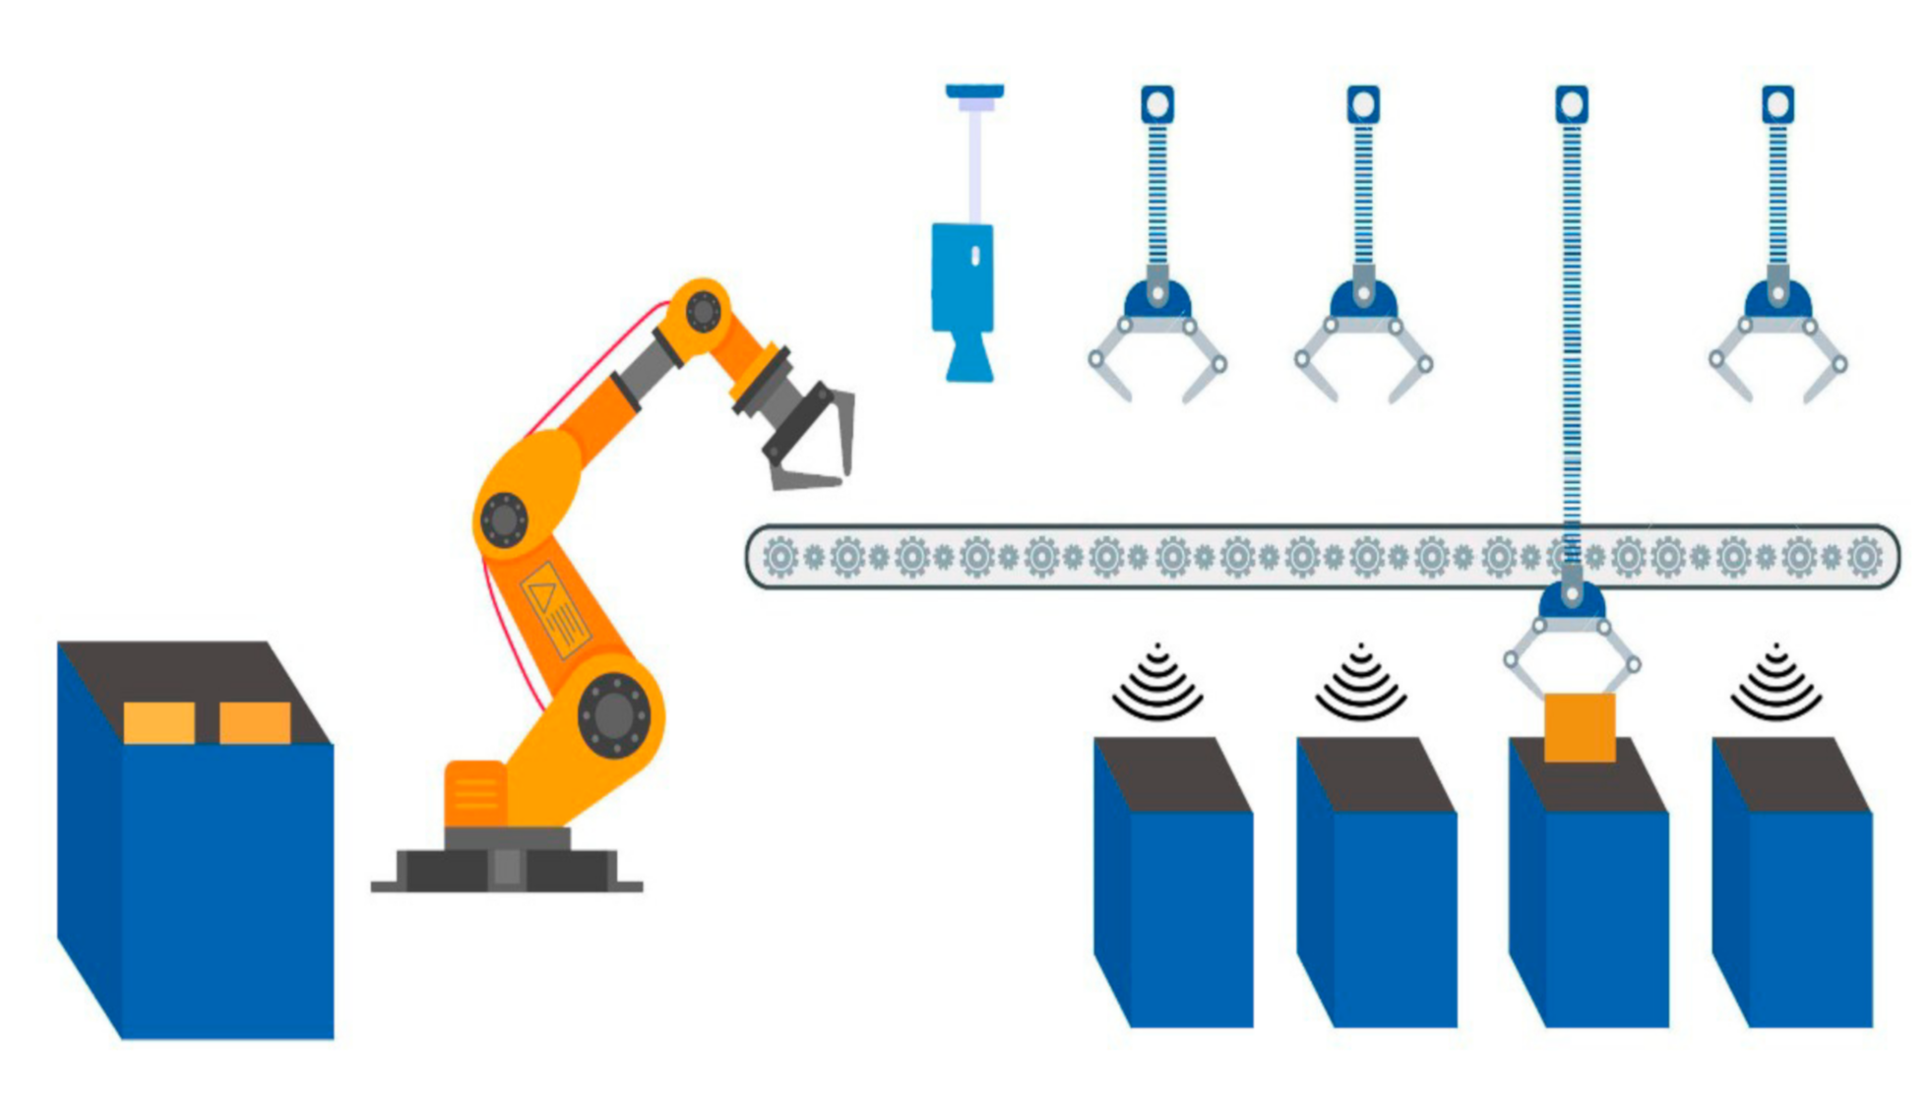
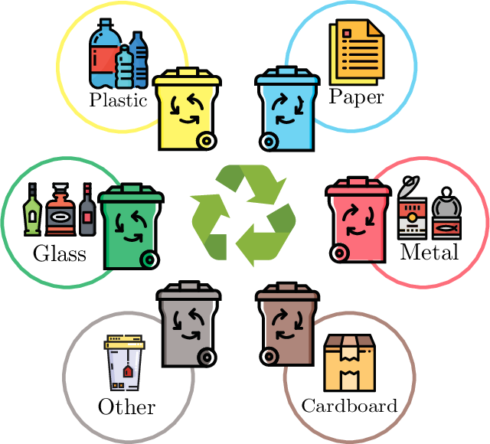
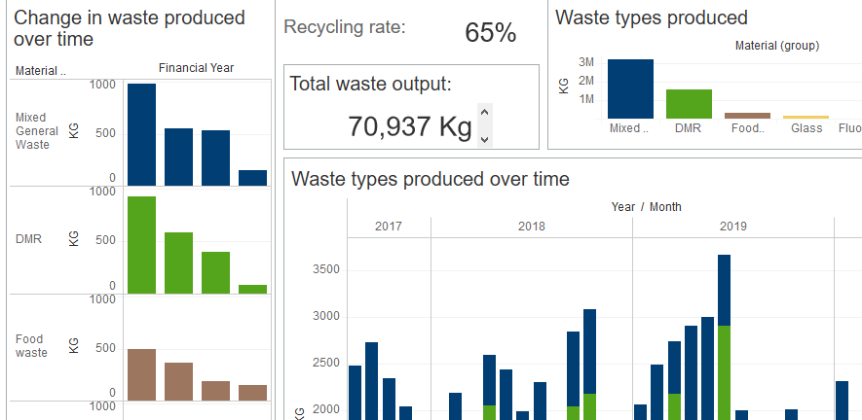
Generative AI Based Fully Automated Robotic Waste Recycle Management System
Key Process of future generative AI based robotic waste recycle management system:
Collect the pertinent historical data from a variety of state-wide data sources which includes waste composition, recycling rates, waste generation trends, recycling technologies, economic variables, and environmental effects.
Process the raw data and combine them into one coherent dataset to avoid any data discrepancies.
Classify the collected data based on waste streams to identify the recyclable materials, potential contamination problems, and waste reduction opportunities.
Feed the data into the AI systems which analyze and provide the insights on waste streams, recycling rates and patterns.
Enable RFID sensor based Smart bins for waste collection which identifies the waste types and stream the live data to generative AI system.
AI systems analyze the unprocessed data from smart bins, predict the types and composition of waste, produce reports, and send them to the authorities in charge of the recycling management system, as well as signal AI-based robots to begin the recycling process.
Data Collection (Sensor’s / AI / ML based garbage collectors
GenAI and Chatbot
Auto segregation
Analysis, reporting and processing using standardized tools

Slide 7
Our Approach – Generative and Effective AI Based Waste Recycling Strategies for Future
Recycled products
Raw Waste and identification
Segregation of Recyclables
Continuous learning and improvement
Reporting, rebates and best practices
Generative AI Based Smart Waste Recycle Management System

Slide 8
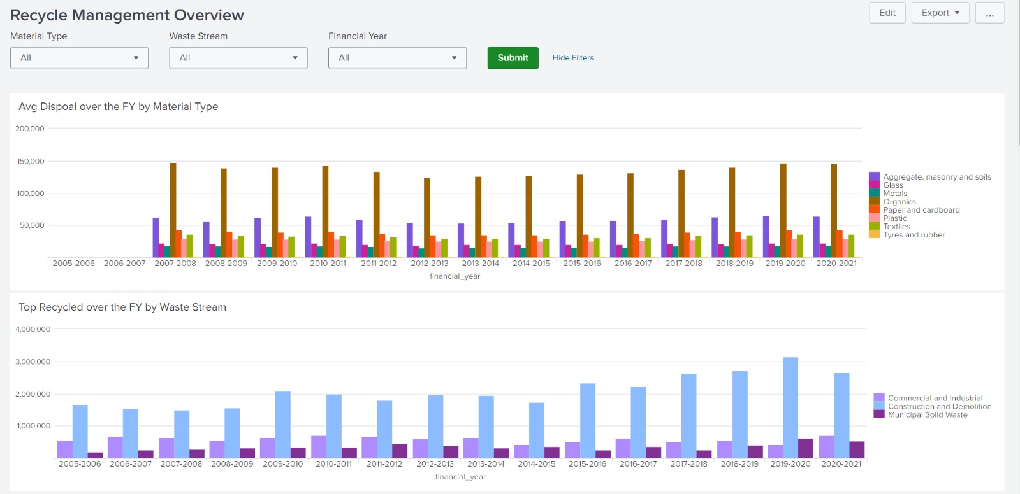
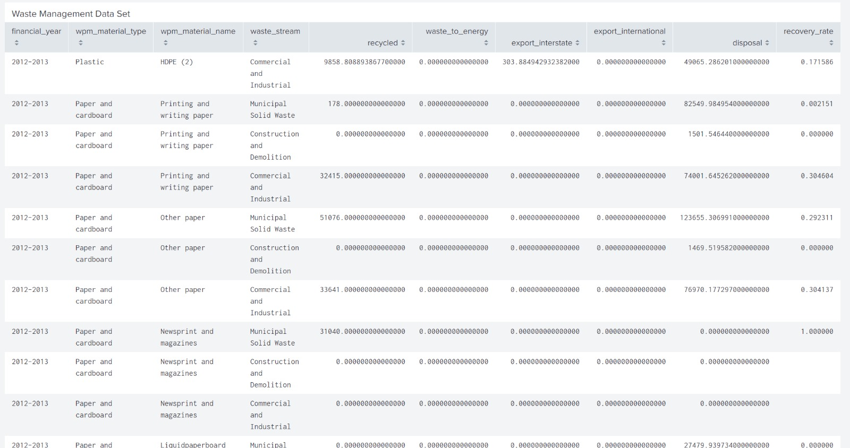
Recyclable Waste Trend Dashboards and Reports

Slide 9
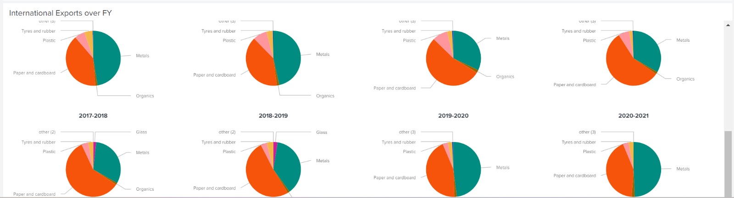
Generative AI Based Predictive Analysis Dashboard & Reports
Pie Charts
Predictive Analysis

Slide 10
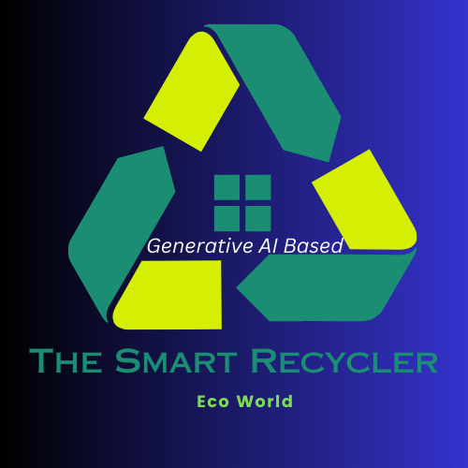
Thank You
Team Gryffindor

